Slide 1

Happy Health In-home Treatment Services
By
Satya Ikyath Varma Dantuluri
Harika Reddy Gurram
Mounica Dantuluri

Slide 2
Problem Statement
A person may be preparing for, or recovering from, surgery, and needs pre and post-operative therapy.
They may be dealing with a debilitating disease or disability while others need assistance because chronic illnesses are affecting their mobility and physical abilities.
In whatever circumstance, the burden of traveling to and from a therapy facility can almost be too much to handle
This works mostly for Children, Senior Citizens and people with emotional and behavioral difficulties.

Slide 3
Solution
Home-based therapies are physically and emotionally motivating for patients.
Benefits include
Convenience: Ease and accessibility is always the first thing for in-home therapy from patient's perspective.
One-on-one care: When treated at home, patients generally feel that they are receiving a higher quality of care.
Increased Functionality: Having a routine translate to the patient’s known environment contributes to better adherence and understanding.
Encouraging & supportive – The familiarity of the same therapist is comforting to patients, and the partnership formed offers a unique type of support.

Slide 4
Approach
We are providing an In-Home treatment for patients, particularly children, senior citizens and insane people to provide them a safe and friendly environment.
We are using technology to improve access to quality care and expand our impact.
Our facilities are being operated across major cities in United States.
Our application is designed to provide care-takers and medicines to doorstep.
Caretakers/Therapists are assigned by highly qualified Doctors upon request by customers.
Hospital Organization act as a bridge between caretakers and patients.
Home delivery of medicines facility is provided by Pharmacies linked to the hospital.

Slide 5

Use Case
Providing In-home treatment for patients to avoid the burden of travelling to health centers and unnecessary visits to physicians. Additionally we are also providing home delivery for medicines.
Main functionalities in application include:
New patient sign-up
Patient schedules an appointment with doctors available in their city, explaining the health issue.
Doctor examines the health complaint of the patient and assigns a Caretaker to attend the patient at their home.
Patients can place order for medicines and get them delivered to home from Pharmacies available in their city.
Hospital Staff places order of medicines required for hospital.

Slide 6

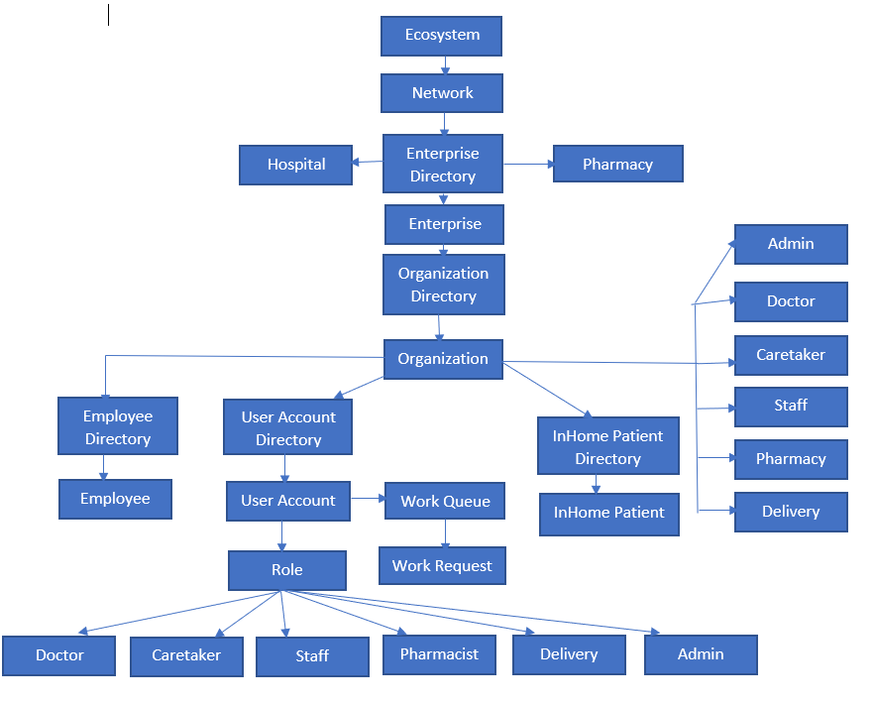
DESIGN

Slide 7

Workflow
Once the patient logs in , he can avail services for In-Home treatment or Medicines delivery available in his City.
Requesting for In-Home care –
Raise or schedule an appointment for any health-related issue that can be treated at home. These requests are routed to Doctors.
Doctor can view the patient requests, accept, analyze and route them to Caretaker with treatment notes.
Caretaker can view and accept the cases sent by doctor and serve the patient as per requested schedule
Request Pharmacy for medicines –
Patient can raise request for medicines to nearby pharmacy available.
Pharmacist views the orders and assign a delivery person.
Delivery person logs in to view the requests routed from the pharmacist and delivers them.
An acknowledgement is sent to the Patients email Id once the delivery person accepts the request.

Slide 8

Login/Home Page

Slide 9
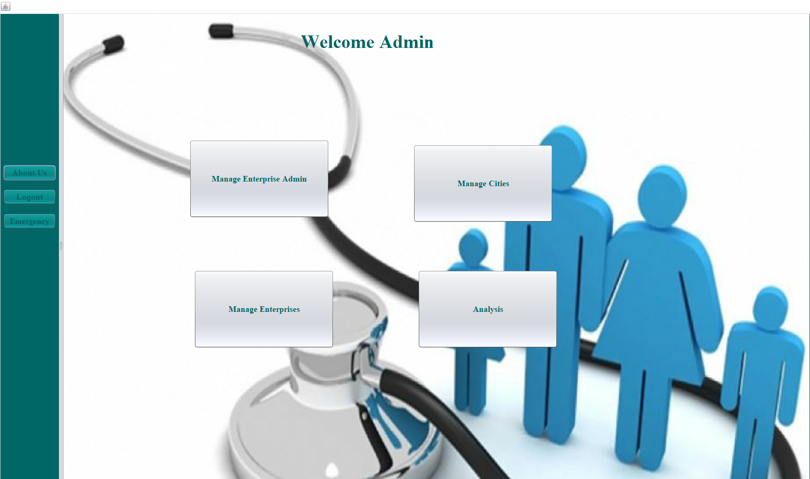
Admin Login Page

Slide 10
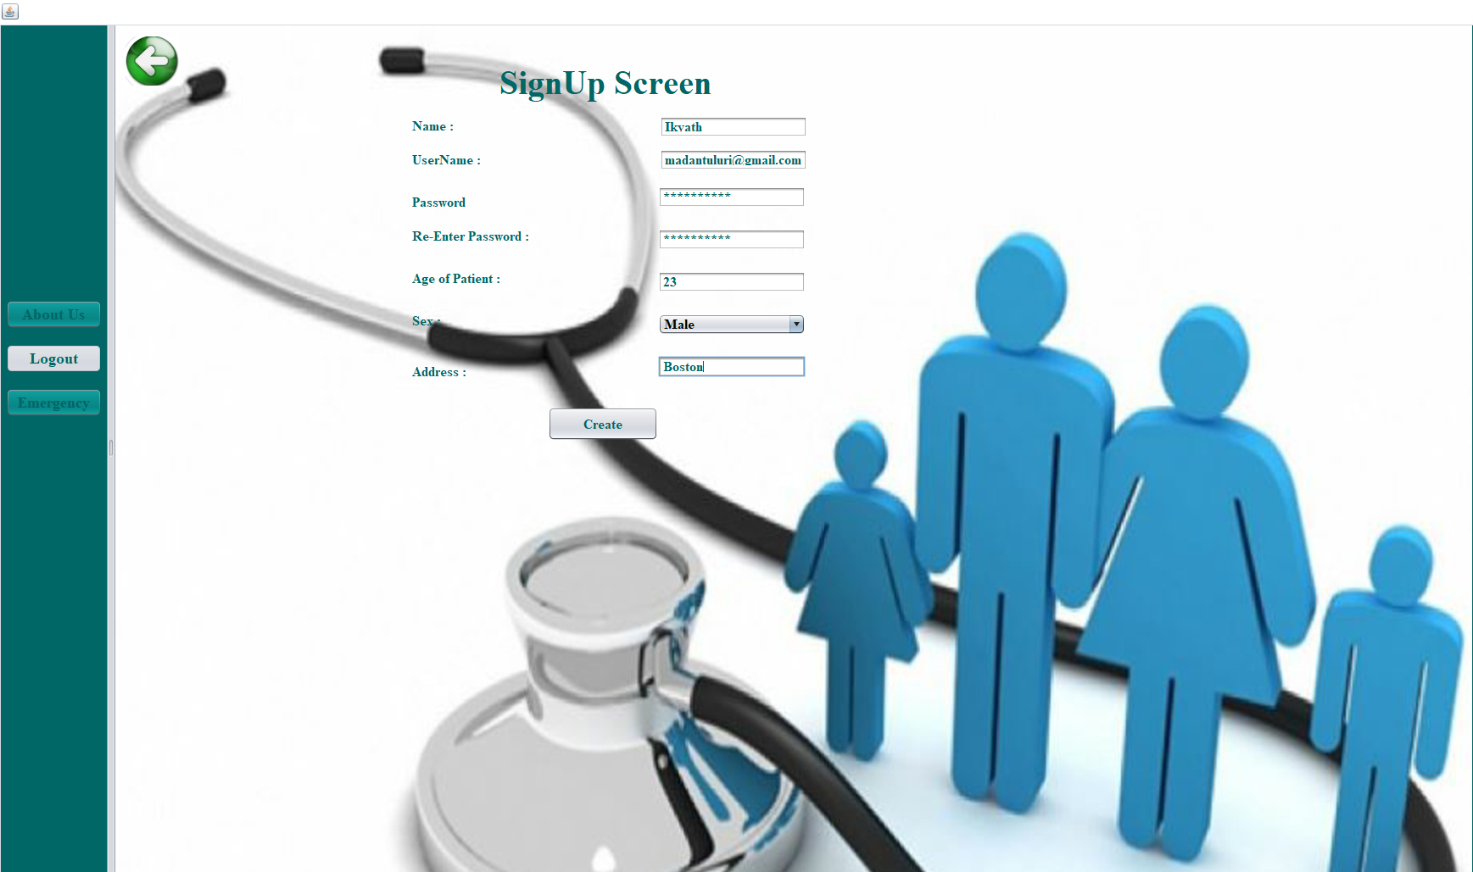
Patient Signup Screen

Slide 11
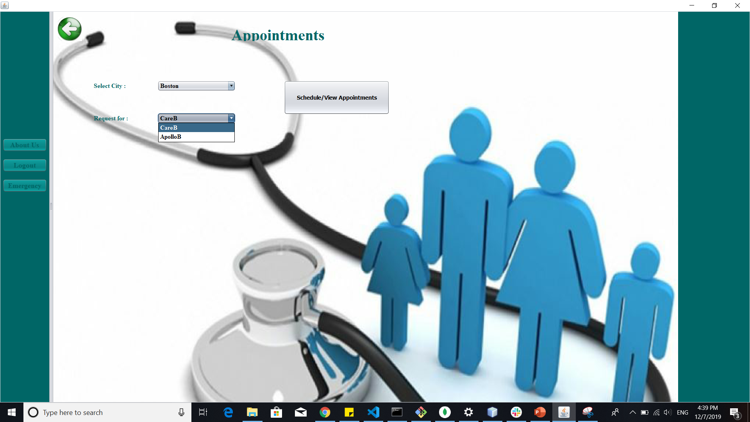
Patient Home Page

Slide 12
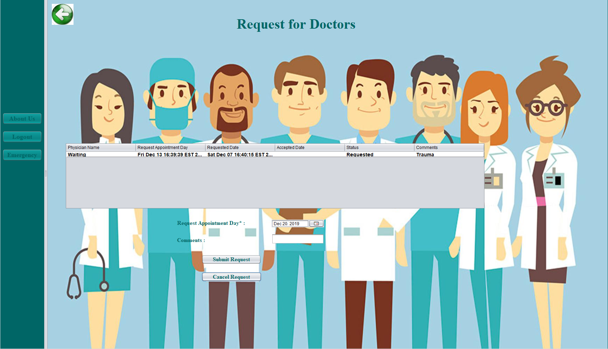
Patient Schedules an Appointment with Doctor

Slide 13
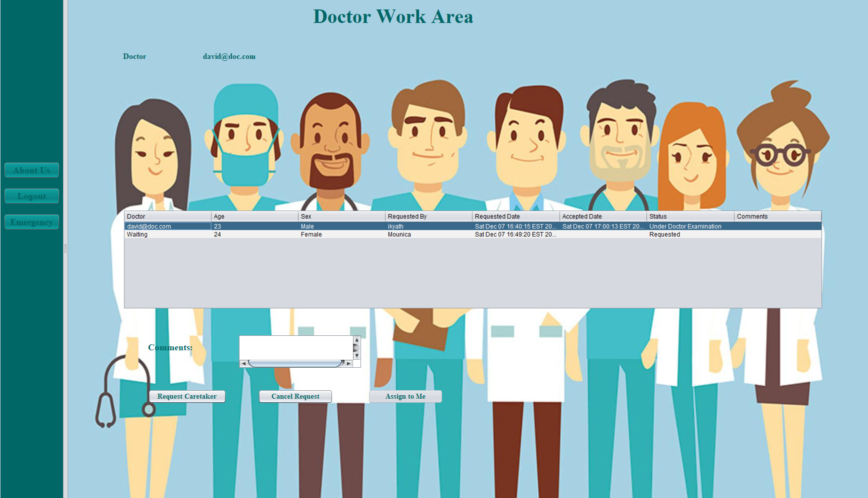
Doctor checks Patients request and assigns Caretaker

Slide 14
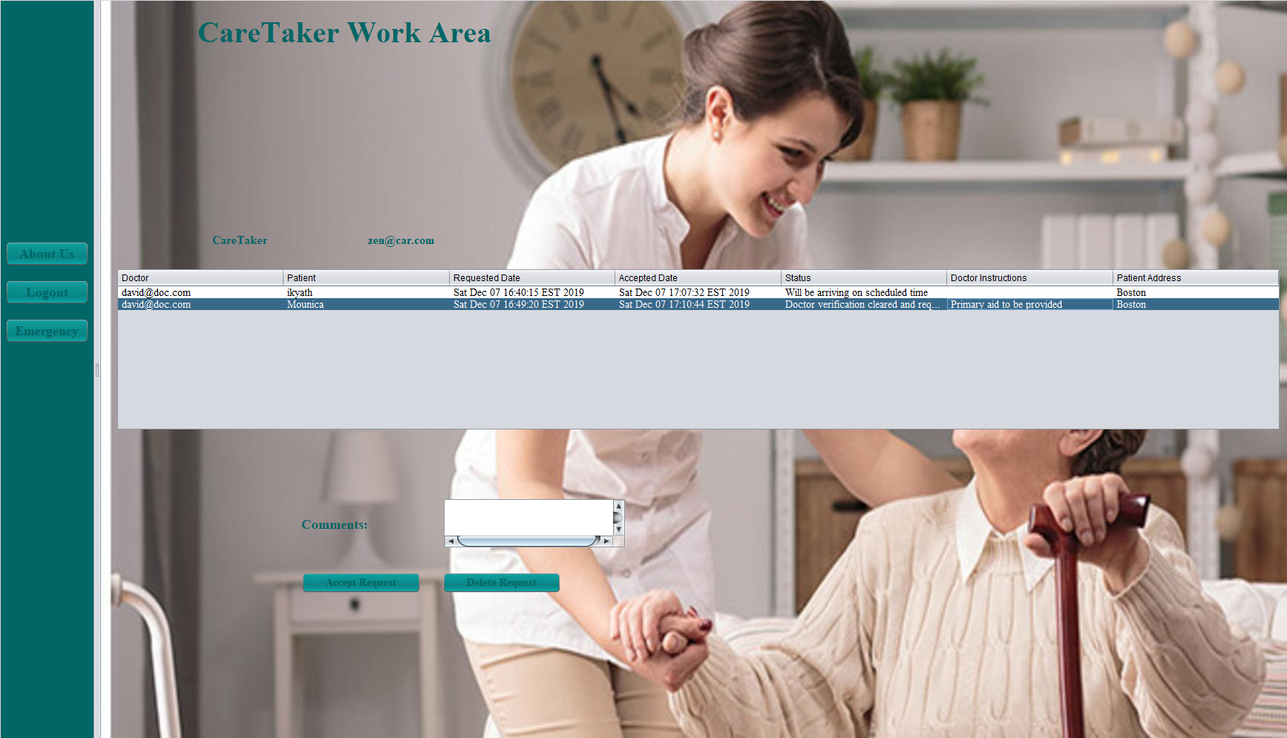
Caretaker Accepts the request and follows Doctor instructions

Slide 15
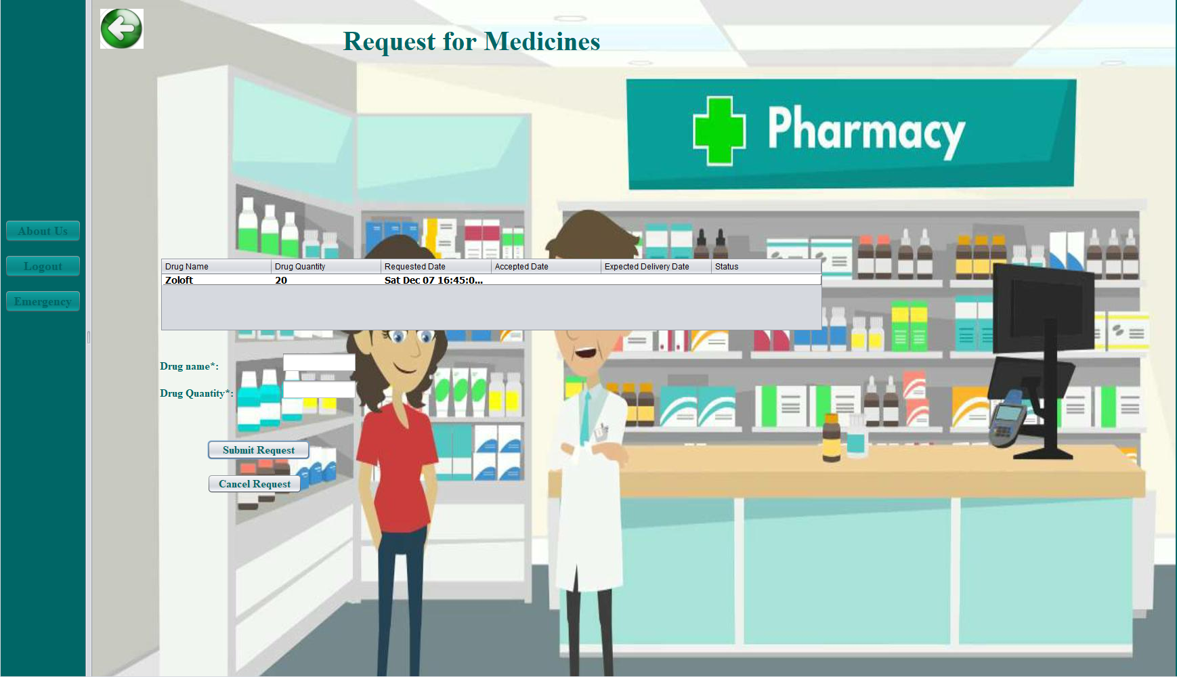
Patient Places Medicines Order

Slide 16
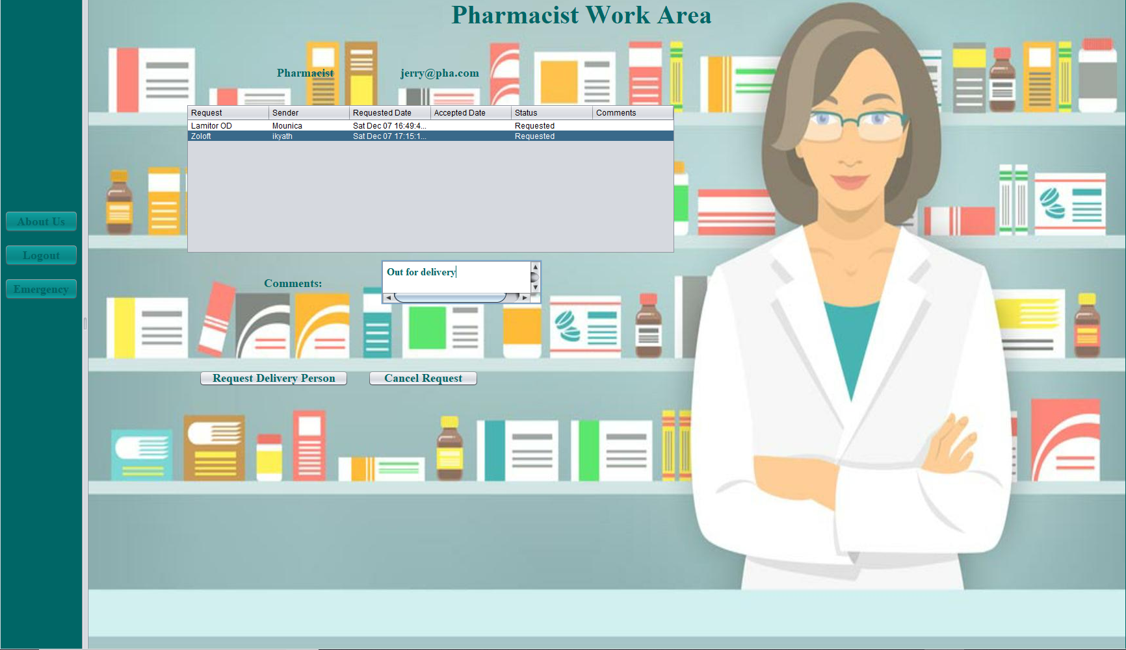
Pharmacist check orders and assigns Delivery Person

Slide 17
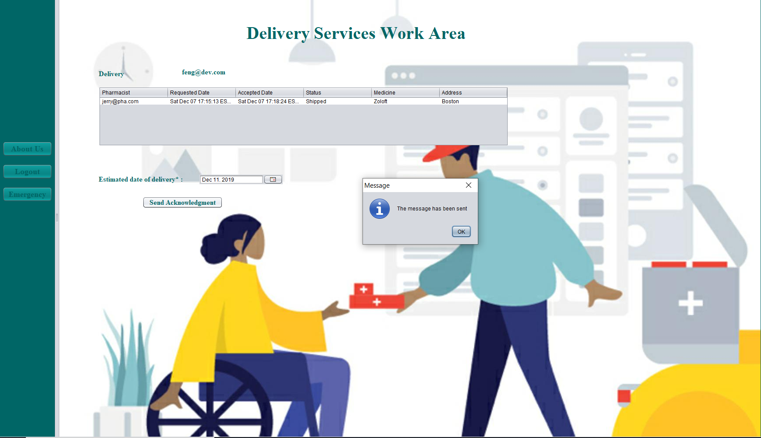
Delivery Person accepts order

Slide 18
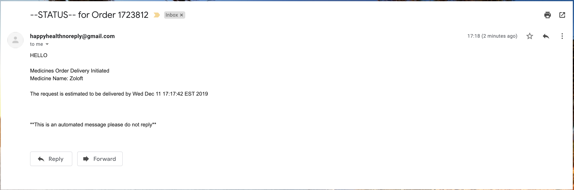
Acknowledge Email sent to Patient

Slide 19
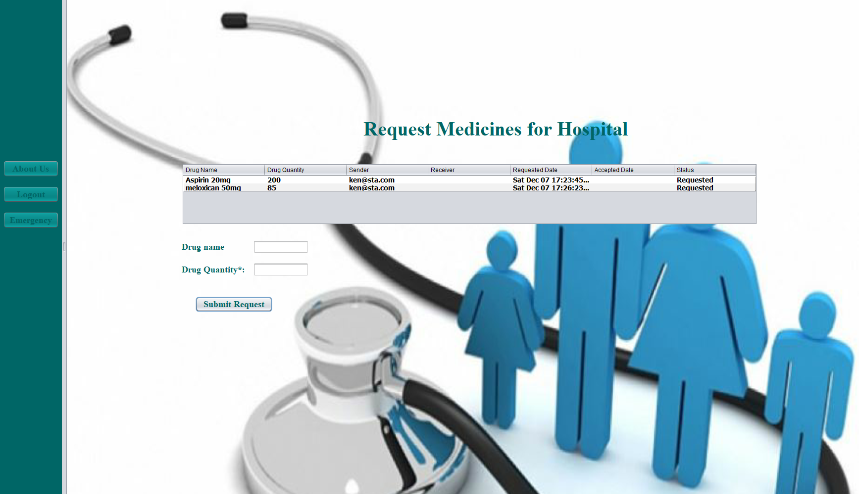
Hospital Staff requests Medicines for Hospital

Slide 20
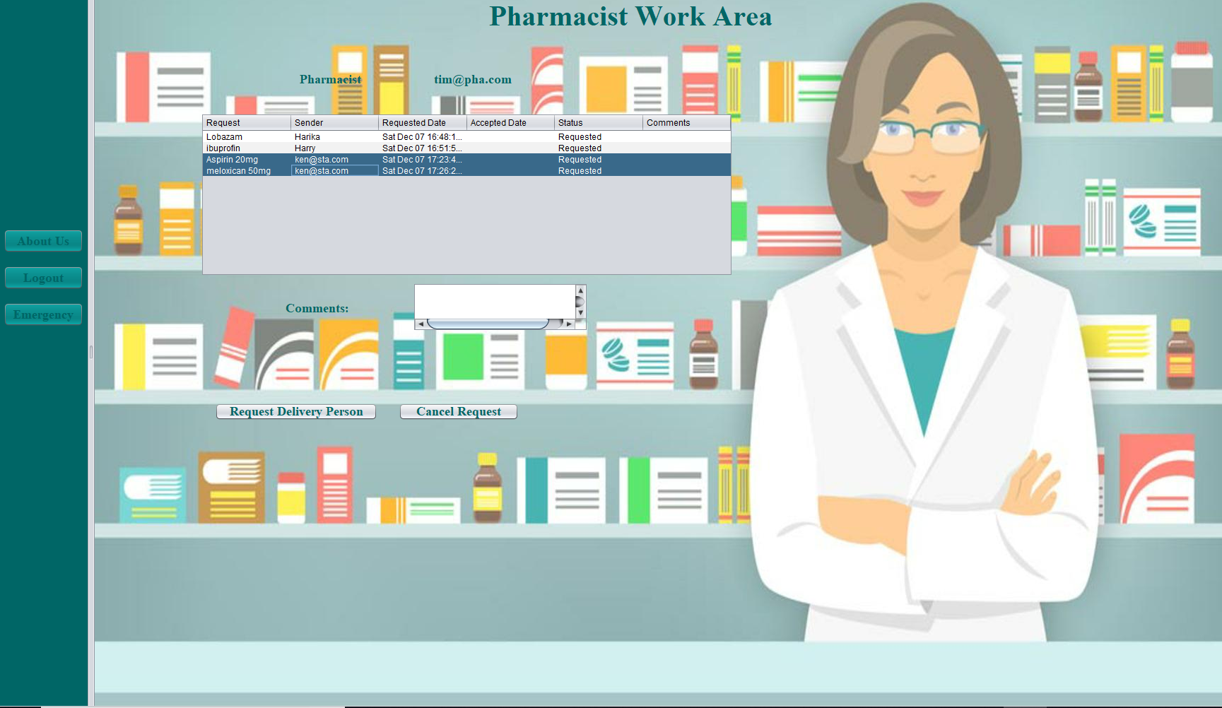
Pharmacist check orders and assigns Delivery Person

Slide 21
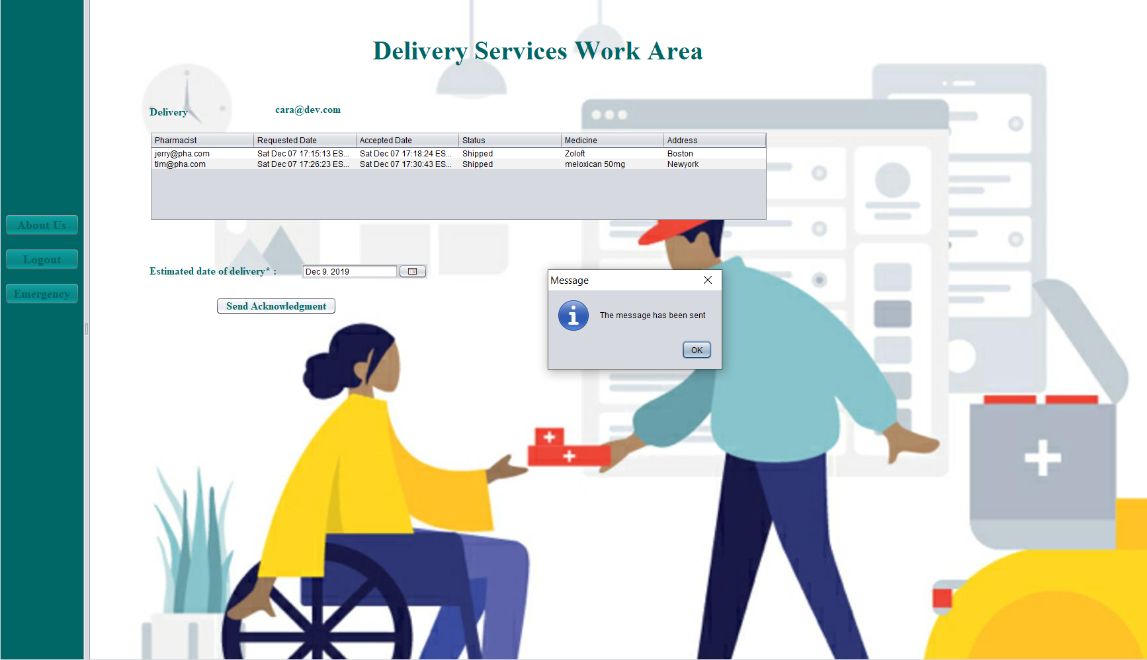
Delivery Person accepts order

Slide 22

Time for Demo

Slide 23

Thank You!!

